Slide 1
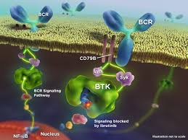
Ibrutinib Discontinuation, Clinical Impact debate
Maha Manachi MD
Medical Director of Al-Bairouni University Hospital
SAO 29TH Conference
Sheraton ,Damascus 27/6/2024
.

Slide 2
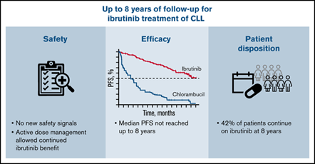
Road Map
Introduction
Analyse previous studies
Definition of discontinuation
short duration
long duration
Studies and highlights
Role of the Hematoloeist
Lesson lernt
Massege to take home

Slide 3
Challenges

Slide 4
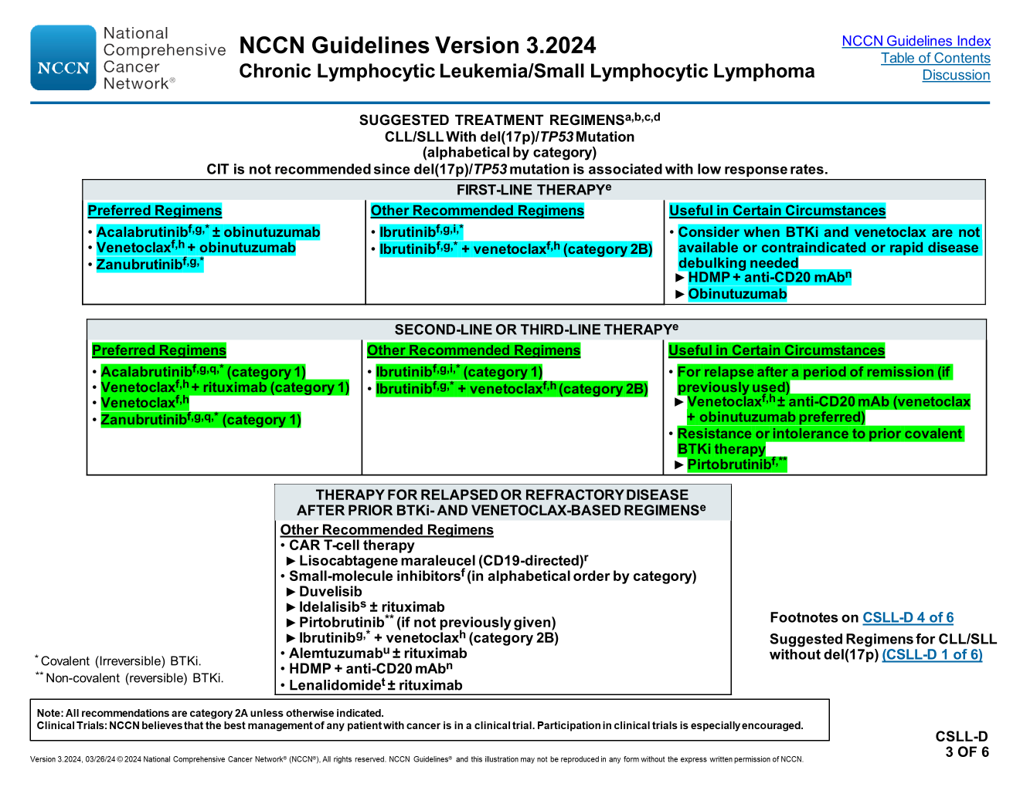
NCCN Guidelines Version 3.2024
Chronic Lymphocytic Leukemia/Small Lymphocytic Lymphoma
NCCN Guidelines Index Table of Contents
Discussion
SUGGESTED TREATMENT REGIMENS^{a,b,c,d}
CLL/SLL Without del(17p)/TP53 Mutation (alphabetical by category)
FIRST-LINE THERAPY^{e}
Preferred Regimens Acalabrutinib^{f,g,*} ± obinutuzumab (category 1) Venetoclax^{f,h} + obinutuzumab (category 1) Zanubrutinib^{f,g,*} (category 1) | Other Recommended Regimens Ibrutinib ^{f,g,i,*} (category 1) Ibrutinib^{f,g,*} + obinutuzumab (category 2B) Ibrutinib^{f,g,*} + rituximab^{j} (category 2B) Ibrutinib^{f,g,*} + venetoclax^{f,h} (category 2B) | Useful in Certain Circumstances Consider for IGHV-mutated CLL in patients aged <65 y without significant comorbidities FCR (fludarabine, cyclophosphamide, rituximab)^{k,l} Consider when BTKi and venetoclax are not available or contraindicated or rapid disease debulking needed Bendamustine^{m} + anti-CD20 mAb^{n,o} Obinutuzumab ± chlorambucil^{p} High-dose methylprednisolone (HDMP) + anti-CD20 mAb^{n} (category 2B; category 3 for patients <65 y without significant comorbidities)
* Covalent (irreversible) BTKi.
Footnotes on CSLL-D 4 of 6
Suggested Regimens for Second-Line and Third-Line Therapy for CLL/SLL without del(17p)/TP53 Mutation (CSLL-D 2 of 6)
Therapy for Relapsed or Refractory Disease After Prior BTKi-and Venetoclax-Based Regimens for CLL/SLL Without del(17p)/TP53 Mutation (CSLL-D 2 of 6)
Suggested Regimens for CLL/SLL With del(17p) (CSLL-D 3 of 6)
Note: All recommendations are category 2A unless otherwise indicated.
Clinical Trials: NCCN believes that the best management of any patient with cancer is in a clinical trial. Participation in clinical trials is especially encouraged.
Version 3.2024, 03/26/24 © 2024 National Comprehensive Cancer Network® (NCCN®), All rights reserved. NCCN Guidelines® and this illustration may not be reproduced in any form without the express written permission of NCCN.

Slide 5
Can we challenge this fact : outcomes of patients with previously untreated CLL who were treated with ibrutinib in clinical trials showed an estimated 7-year PFS and OS of 80% and 75%, respectively
We don’t have results of trails that designated to study the indication , safety, efficacy of (stop ibrutinib).
Analyse previous reports & studies and follow the result of patients with episodes of Ibrutinib discontinuation (either short or long ).

Slide 6
372 pts

Slide 7
Patient characteristics at initiation of ibrutinib (n = 372)
Parameter | n (%) or median (range)
 | 259 (70)
Treated on clinical trial | 57 (15)
Frontline therapy | 113 (30)
Rai stage
0 | 42 (13)
I–II | 115 (37)
III–IV | 158 (50)
Missing | 57
Absolute lymphocyte count, ×10⁹/L | 38.3 (0.1–436.4)
Missing | 16
IGHV mutation status
Unmutated | 233 (75)
Missing | 61
Fluorescence in situ hybridization
Normal | 55 (16)
Other | 5 (2)
13q‐ | 96 (29)
Trisomy 12 | 58 (17)
11q‐ | 68 (20)
17p‐ | 53 (16)
Missing | 37
TP53 disruption (del17p and/or TP53 mutation)
Abnormal | 68 (20)
Missing | 34
Oncologist
. 2020 Nov;25(11):974-980. doi: 10.1634/theoncologist.2020-0388.

Slide 8
Clinical Findings and Management in Patients with Disease Flare
27holds (11% of 245 holds) in 21 patients (15% of 143 patients) involved:
A mild disease flare. The symptoms of disease flare in these cases involved fatigue/malaise (n = 13), fever (n = 13), painful lymph nodes (n = 7), night sweats (n = 2), and other (n = 3; body aches [n = 1], headache [n = 1], abdominal pain [n = 1]); 10 holds were associated with multiple symptoms. Management involved restarting ibrutinib in all 27 holds, as well as methylprednisolone in one patient.
14 holds (6% of 245 holds) in 14 unique patients (10% of 143 patients) had an associated severe disease flare. Qualifying findings included new or worsening symptoms (n = 13), new or worsening lymphadenopathy or splenomegaly (n = 12), and ALC and/or LDH increase (n = 9). Of the 13 patients with new or worsening symptoms, symptoms included fatigue/malaise (n = 9), fever (n = 3), night sweats (n = 3), painful lymph nodes (n = 2), myalgias (n = 2), nausea (n = 1), dyspnea (n = 1); 6 patients had multiple symptoms. All 14 patients were managed with restarting ibrutinib with resolution of the signs and symptoms associated with the acute disease flare; no deaths occurred as a result of the flare. High‐dose methylprednisolone (n = 6) and rituximab (n = 3) were used as adjuncts in a subset of patients
Oncologist
. 2020 Nov;25(11):974-980. doi: 10.1634/theoncologist.2020-0388

Slide 9
Benefit of Dose Reduction

Slide 10
Background: Dose reduction (DR) has been used to manage treatment-related adverse events (AEs) effectively and avoid early treatment discontinuation in patients (pts) with CLL/SLL receiving ibrutinib (ibr) in the first-line (1L) setting.
This study evaluated DR and time to next treatment (TTNT) following AE in Medicare pts with CLL/SLL who were initiating ibr
Methods: Medicare Fee-for-Service (FFS) closed claims and enrollment data were used to identify pts with CLL/SLL who initiated 1L single-agent ibr (420 mg/day) from January 2014 to September 2020 with an incident AE following treatment initiation. Ibr DR was defined as reduction of starting dose following the first reported incident AE
TTNT was defined as time from first incident AE to initiation of a new agent (#90 days of ibr discontinuation) or death and was compared in pts with and without DR using Kaplan-Meier analysis and a time-varying Cox proportional hazards model

Slide 11
Dose Reduction of Ibrutimib,1line
Results:
Of 3575 pts included in the analysis (median age: 76 years; male: 63.4%), 459 (12.8%) had a DR. Duration of 1L ibr, time to first incident AE, time to DR, and TTNT varied among study cohorts. Median TTNT (standard deviation [SD]) for pts with and without DR was 49.8 months (1.4) and 22.0 months (0.6), respectively.
After 6 and 12 months of follow-up, significantly fewer pts with DR discontinued treatment than pts without DR (6 months: 8.3% vs 27.3%, P = 0.0062; 12 months: 13.8% vs 38.2%, P = 0.0003). A
A total of 51 pts discontinued treatment immediately after the first incident AE; 414 deaths were reported within 90 days of the first incident AE. After controlling for baseline demographics and clinical characteristics as well as time-varying HCRU and costs, pts with DR were not significantly likely to discontinue treatment compared with pts without DR (hazard ratio [95% CI], DR vs no DR: 0.89 [0.71–1.12]). Increased age, comorbidity index score, healthcare costs, and number of hospitalizations were significant predictors of treatment discontinuation. Conclusions: Among Medicare FFS pts with CLL/SLL and an AE following initiation of 1L ibr, pts with DR remained on therapy significantly longer than pts without DR. Ibr DR may be an effective strategy to manage tolerability while maintaining clinical efficacy.

Slide 12
This study used Medicare claims (2013–2019)(11,870 new ibrutinib initiators )
to examine ibrutinib discontinuation and associated factors among elderly patients with chronic lymphocytic leukemia (CLL)/small lymphocytic lymphoma (SLL).
Over a median follow-up of 2.1 years, two-thirds (65.2%) of the 11,870 new ibrutinib initiators were discontinued, with half (45.1%) of patients discontinuing within 12 months of initiation. Factors such as advanced age, lack of Part D low-income subsidy, evidence of prior CLL/SLL treatment, and cardiovascular comorbidities (e.g. atrial fibrillation) were associated with higher risk of discontinuation.
Over a median of 1.2 years from discontinuation, 40% of discontinuers initiated another CLL/SLL treatment after ibrutinib discontinuation; 25% of patients restarted ibrutinib treatment at some point over follow-up. Our findings point to a large unmet need with the widely used BTKi ibrutinib and underscore the importance of ongoing development of efficacious and well-tolerated CLL/SLL therapies.

Slide 13
conclusion, this largest real-world study to date of elderly patients with CLL/SLL initiating ibrutinib shows high rates of discontinuation and low rates of initiation of another CLL/SLL treatment.
Discontinuation was more likely in those with advanced age, frailty, refractory CLL/SLL, lack of a Part D LIS, and cardiovas-cular comorbidities such as atrial fibrillation. Taken together, our findings point to a large unmet need with the widely used BTKi ibrutinib.
Clinicians should be made aware of the patient characteristics associate
with ibrutinib discontinuation and closely monitor patients accordingly.
Alternatively, these patients who have higher risk of discontinuation on ibrutinib maybe ideal candidates for other novel agents that offer abetter safety and/or efficacy profile. Future research should examine how newer novel agents (e.g. BCL-2s,next-generation BTKis) address this unmet need inelderly patients with CLL/SLL

Slide 14
Real-world treatment patterns, discontinuation and clinical outcomes in patients with B-cell lymphoproliferative diseases treated with BTK inhibitors in China State Key Laboratory of Experimental Hematology, National Clinical Research Center for Blood Diseases, Haihe Laboratory of Cell Ecosystem, Institute of Hematology & Blood Diseases Hospital, Chinese Academy of Medical Sciences & Peking Union Medical College, Tianjin f Healh Science, Tianjin, China
Sec. Cancer ImmunitORIGINAL RESEARCH article
Front. Immunol., 07 July 2023
y and Immunotherapy
Volume 14 - 2023
https://doi.org/10.3389/fimmu.2023.1184395
673 Chinese patients BLPD (WM/LPL-CLL-MCL)
January 2014 to October 2022
Discontinuation gap of ≥90 days in treatment
The study examined the impact of treatment duration and reasons for discontinuation on survival.
At the last follow-up, 288 (42.8%) patients had discontinued BTKi-based treatment.
The reasons for discontinuing BTKi were grouped into four categories.

Slide 15
BTKi discontinuation time and reason

Slide 16
BTKi discontinuation time and reason
288 (42.8%) patients had discontinued BTKi-based treatment.
The reasons for discontinuing BTKi were grouped into four categories.
Statistically, significant longer time of BTKi adherence were observed in patients with first-line therapy.
First, 89 of the 288 patients discontinued BTKi due to toxicity (30.9%).
Among those who discontinued due to toxicity, the most common causes for discontinuation were infection (40.4%), followed by thrombocytopenia or bleeding (16.9%), skin rash (10.1%), neutropenia (9.0%), cardiac arrhythmia (9.0%), anemia (4.5%), and reactivation of hepatitis B (4.5%).
Second, 140 of the 288 patients discontinued BTKi due to progression, transformation or death (48.6%). 98 of the 140 patients (70.0%) were R/R patients.
Third, 11.8% patients (34/288) withdrew BTKi due to unaffordable insurance or patients’ preference.
Fourth, 8.7% patients (25/288) discontinued BTKi according to the professional suggestions. Of those, 16 patients finished the treatment course of BTKi+FCR and reached minimal residual disease (MRD)-negative complete remission (CR). Following the physician’s advice, these patients discontinued BTKi and started regular post-withdrawal follow-up checks. Other patients discontinued BTKi or changed treatment regimens in preparation for surgery or allo-transplantation
Notes:
Patients treated with ibrutinib had a higher risk of
discontinuing treatment during follow-up compared to those
treated with zanubrutinib (47.2% vs. 29.1%, P<0.001, Figure 2A).
The discontinuation difference between the two BTKi was largely
due to toxicity (15.3% vs. 9.1%, P=0.047). The frequency of BTKi
discontinuation varied by regimen, with the highest rate observed
among patients treated with BTKi combined with a CHOP-like
regimen (60.0% vs. 41.7% for other regimens, P=0.027). Patients
treated with BTKi combined with BR/FCR showed a comparable
rate of discontinuation than patients treated with BTKi
monotherapy (Figure 2B)

Slide 17
BTKi discontinuation time and reason
Among the 288 patients who had discontinued BTKi during follow-up,
26.4% of those discontinued within 6 months on BTKi identified as early discontinuation. The major reason for early discontinuation was toxicity (48.7%), followed by disease progression (42.1%). Patients with early discontinuation had extreme worse outcome with a median PDS of only 6.9 months.
patients who discontinued after 24 months on BTKi had a significantly longer survival whatever the withdrawal cause (median PDS: 46.5 months vs. 13.2 months for those discontinued in 12-24 months, P=0.003, Figure 6A).
When we looked into the effect of discontinuation reason on survival, patients who discontinued due to toxicity had similar post discontinuation survival to those who discontinued due to disease progression (median PDS 10.8 and 11.1 months, P=0.776). Patients who withdrew BTKi due to economic reasons or professional suggestion had relatively longer survival after BTKi discontinuation compared to other reasons (median PDS 46.5 and not reach, respectively, Figure 6B). In our subgroup analysis of specific disease subtypes and treatment statuses, we observed that patients with CLL and WM/LPL, as well as both treatment-naïve and relapsed/refractory patients, who discontinued BTKi due to toxicity or within 6 months had significantly shorter post-BTKi survival (Supplementary Figure 3). However, the reason for discontinuation held no prognostic significance in patients with MCL (Supplementary Figure 3E)
Notes:
Patients treated with ibrutinib had a higher risk of
discontinuing treatment during follow-up compared to those
treated with zanubrutinib (47.2% vs. 29.1%, P<0.001, Figure 2A).
The discontinuation difference between the two BTKi was largely
due to toxicity (15.3% vs. 9.1%, P=0.047). The frequency of BTKi
discontinuation varied by regimen, with the highest rate observed
among patients treated with BTKi combined with a CHOP-like
regimen (60.0% vs. 41.7% for other regimens, P=0.027). Patients
treated with BTKi combined with BR/FCR showed a comparable
rate of discontinuation than patients treated with BTKi
monotherapy (Figure 2B)

Slide 18
Prognostic factors of post-BTKi survival
We found line of therapy, depth of response less than PR, elevated LDH level with complex karyotype, with 17p deletion, withdrawal BTKi by toxicity and withdrawal BTKi within 6 months were associated with inferior post BTKi FFS and OS (Supplementary Figure 4; Figure 7).
Besides, the following variables were also associated with inferior post BTKi OS: age>65 and commercial BTKi use other than participating a clinical trial (Figure 7). However, no significant impact on outcome was identified among patients receiving different generations of BTKi (P=0.491, Figure 7B).
Similar conclusions were reached when we considered only patients with CLL (Supplementary Figure 5).
Besides, patients with combination had a trend of better postBTKi FFS than those with monotherapy therapy but with no statistical significance (P=0.058). To determine the independent factors associated with post BTKi survival, we included all the factors significant in univariate analyses in a multivariate Cox model. Finally, category of disease (hazard ratio [HR] = 1.8, P=0.021), age>65 (HR = 1.6, P=0.045), with 17p deletion (HR = 2.7, P
Notes:
Patients treated with ibrutinib had a higher risk of
discontinuing treatment during follow-up compared to those
treated with zanubrutinib (47.2% vs. 29.1%, P<0.001, Figure 2A).
The discontinuation difference between the two BTKi was largely
due to toxicity (15.3% vs. 9.1%, P=0.047). The frequency of BTKi
discontinuation varied by regimen, with the highest rate observed
among patients treated with BTKi combined with a CHOP-like
regimen (60.0% vs. 41.7% for other regimens, P=0.027). Patients
treated with BTKi combined with BR/FCR showed a comparable
rate of discontinuation than patients treated with BTKi
monotherapy (Figure 2B)

Slide 19
Conclusions
In conclusion, despite higher rates of discontinuation than anticipated, our study demonstrated that BTKi is an effective and well-tolerated treatment for long-term use in Chinese patient population.
Early discontinuation and withdrawal BTKi by toxicity were confirmed to be predictors of post-BTK survival, independent of response depth, lines of therapy and baseline cytogenetics including 17p deletion.
Further investigation is necessary to identify patients at high risk of poor adherence, and better guide optimal individualized treatment decisions.

Slide 20
Is It Safe to Stop Ibrutinib Therapy for CLL After Multiple Years? November 14, 2023 In science and medicine, information is constantly changing and may become out-of-date as new data emerge. All articles and interviews are informational only, should never be considered medical advice, and should never be acted on without review with your health care team.Authored by Dr. Brian Koffman
Methods and Participants:
The research looked at 172 participants treated with IBR in the FLAIR trial who had a baseline evaluation before May 3, 2017, to be followed for at least seven years (6 years of treatment and one year of follow-up).
112 participants stopped ibrutinib at the end of treatment (EoT) of 72 months
15/112 (12%) had achieved uMRD4 in the blood at EoT: All maintained uMRD4 in the blood at six months (10/15 evaluable) and 12 months (13/15 evaluable) after EoT. 41/112 (37%) had very low level of disease but not quite uMRD4 with 0.01-1% disease at Eo

Slide 21
Is It Safe to Stop Ibrutinib Therapy for CLL After Multiple Years? November 14, 2023 In science and medicine, information is constantly changing and may become out-of-date as new data emerge. All articles and interviews are informational only, should never be considered medical advice, and should never be acted on without review with your health care team. Authored by Dr. Brian Koffman
Conclusions:
In most CLL patients who have received six years of ibrutinib, the levels of residual disease decrease or remain stable for the subsequent 6-12 months after stopping ibrutinib. How much is real disease control off therapy and how much is due to redistribution of cells from the bloodstream to the lymph nodes and bone marrow will only be answered by longer follow-up.
However, the stability of disease levels after treatment cessation supports the safety and advisability of testing an intermittent treatment strategy to determine whether this approach could potentially reduce treatment-emergent resistance and forces us to at least research and reassess the dogma of treating with BTKis until progression or intolerance.

Slide 22
Stop Ibrutinib Trails?

Slide 23
Stop Ibrutinib Trails
Ibrutinib discontinuation trial:
The NCI-CONNECT (NCT03720145) is a phase II clinical trial that aims to evaluate the feasibility and safety of discontinuing ibrutinib in patients with previously treated chronic lymphocytic leukemia (CLL). The study is enrolling patients who have achieved a complete response (CR) or stable disease after at least 12 months of ibrutinib therapy.
Trexall discontinuation trial:
The TREXALL study (NCT03134754) is a phase III clinical trial that assesses the feasibility and efficacy of discontinuing ibrutinib in patients with CLL or small lymphocytic lymphoma (SLL) who have achieved a CR or partial response (PR) after at least 24 months of treatment

Slide 24
Massage to take home
MDT evaluation and decision
Dose Reduction need to be considered while managing Ibrutinib SE
Haematologist Close follow up
Try not to Hold on Ibrutinib frequently
We don’t have guidelines yet when to stop ibrutinib
Results of previous experience doesn’t encourage early discontinuation
Consider selection Criteria, evaluate the disease and close monitoring

Slide 25
Thank You

